Slide 1
Adaptive Landscape Genetics and Malaria Susceptibility in Island Bird Populations
— Exploring the Evolutionary Dynamics of Berthelot’s Pipits Across Different Ecosystems
William Holley
Luc-Tanton Tran
Guanzhi Wang

Slide 2
Introduction & Research Background
- Malaria is a major evolutionary pressure affecting wildlife.
- Berthelot's pipits, a small bird species, are studied on two islands: Tenerife and Porto Santo.
- Genetic and environmental factors contribute to malaria susceptibility.
- Understanding these factors helps in disease ecology and conservation efforts.

Slide 3
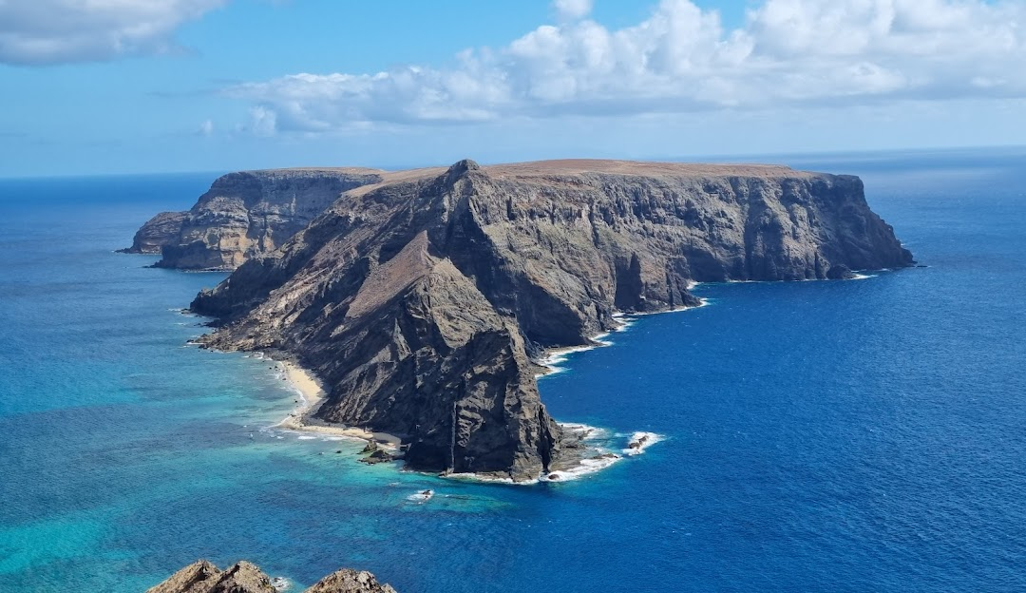


Slide 4
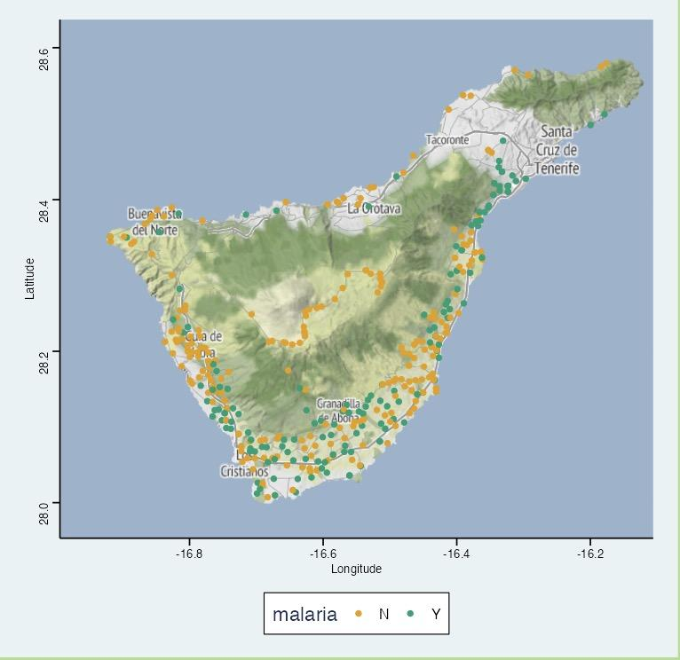
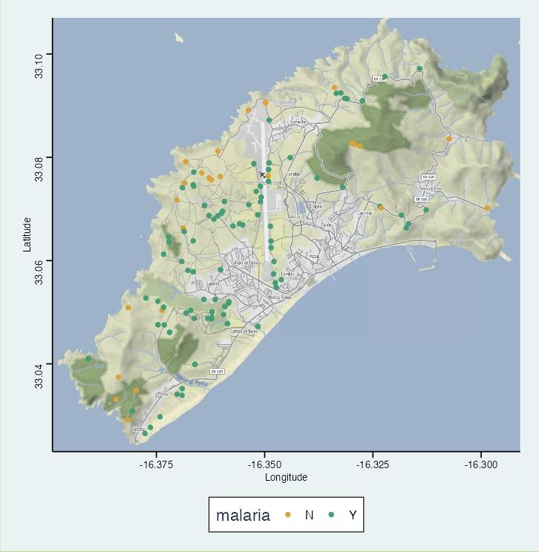
Malaria Infection Across Two Islands
Tenerife
Porto Santo

Slide 5
Malaria vs Environment
Malaria vs Genetics
Water Sources
Urban Areas
Livestock Farms
Poultry Farms
SNP(single nucleotide polymorphisms)
TLR4 Gene Haplotypes

Slide 6
Next
SHINY APP

